Slide 1
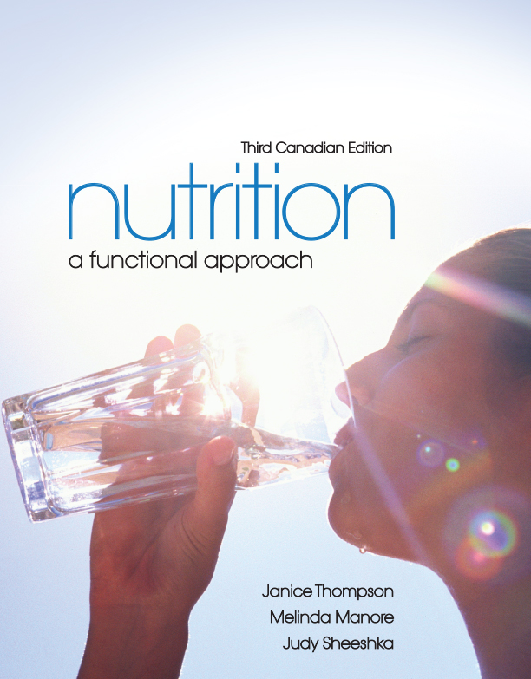
Achieving and Maintaining a Healthful Body Weight and In Depth

Slide 2
What Is a Healthful Body Weight?
A healthful weight
  Is appropriate for your age and physical development
  Is maintained without constant dieting
  Is acceptable to you
  Is based on family history of body shape and weight
  Promotes good eating habits and allows for regular physical activity

Slide 3
Evaluating Body Weight
A person’s actual weight is not the only factor to consider
Determining if a person’s body weight is healthful should include
  Determining the body mass index (BMI)
  Measuring body composition
  Assessing the pattern of fat distribution

Slide 4
Evaluating Body Weight
Body mass index
  Expresses the ratio of a person’s weight to the square of his or her height
  BMI = weight (kg)/height (m)²
  BMI values below 18.5 or above 30 have increased risks of health problems
  BMI results are distorted in people with high muscle mass (athletes and lactating women)

Slide 5
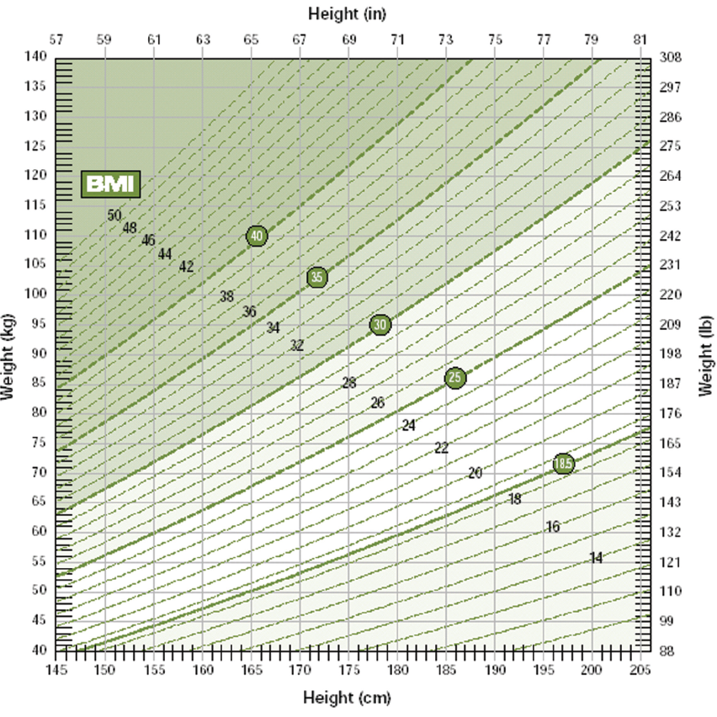
Evaluating Body Weight
[insert Figure 11.1]
Figure 11.1

Slide 6
Evaluating Body Weight
Why is BMI important?
BMI provides an important clue to overall health
Underweight (BMI <18.5)
Normal weight (BMI 18.5-24.9)
Overweight (BMI 25.0-29.9)
Obesity (BMI 30.0+)

Slide 7
Evaluating Body Weight
Limitations of the Body Mass Index
The BMI is not appropriate for those who
are:

Slide 8
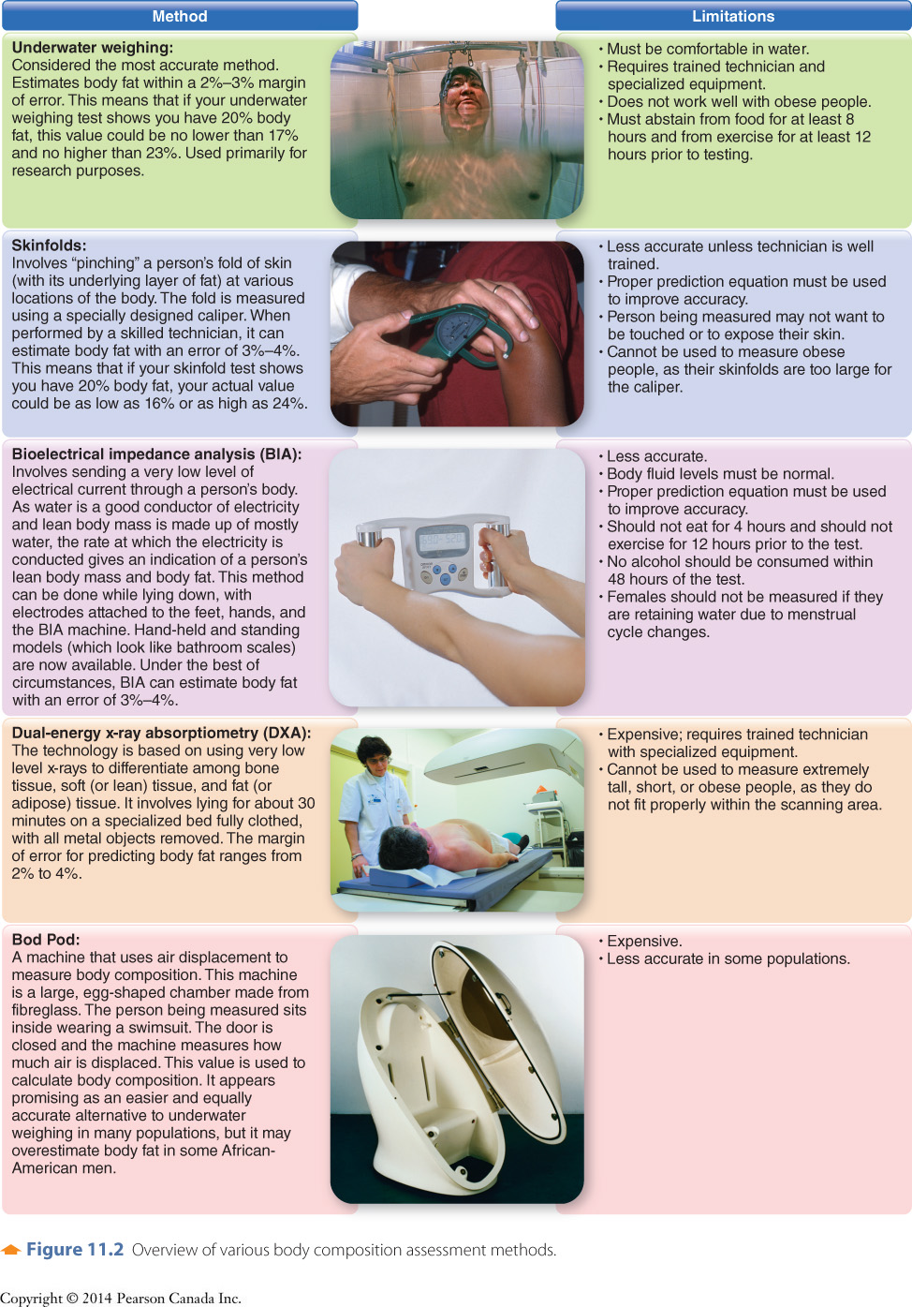
Evaluating Body Weight
Figure 11.2

Slide 9
Evaluating Body Weight
Figure 11.2

Slide 10
Evaluating Body Weight
Figure 11.2

Slide 11
Evaluating Body Weight
Figure 11.2

Slide 12
Evaluating Body Weight
Figure 11.2

Slide 13
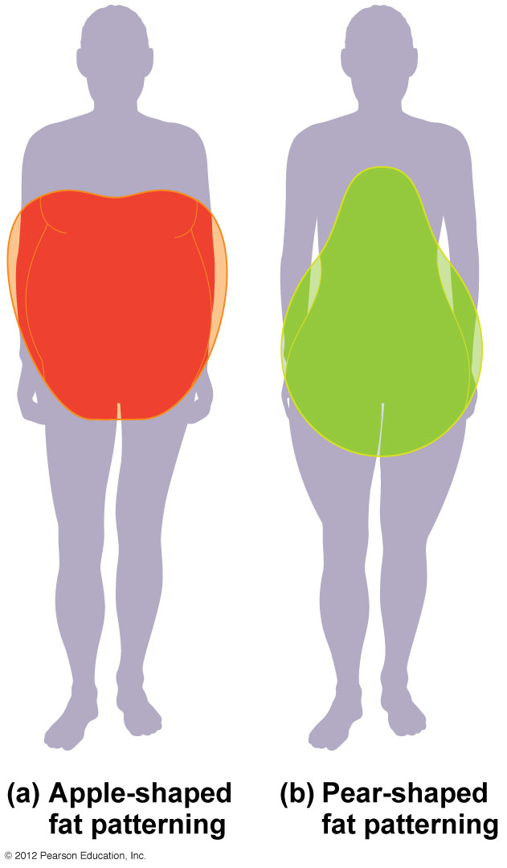
Evaluating Body Weight
Figure 11.3: a, b

Slide 14
Gaining or Losing Weight
Whether a person gains or loses weight depends on
  Energy intake versus energy expenditure
  Genetic factors
  Composition of the diet
  Childhood weight
  Behavioural factors
  Social factors

Slide 15
Energy Balance
Energy balance
  Occurs when energy intake = energy expenditure
  Energy intake = kcal from food
  Energy expenditure

Slide 16
Energy Balance
Basal metabolic rate (BMR)
  Energy expended to maintain basal, or resting, functions of the body
  60–75% of total energy expenditure
  More lean tissue increases your BMR
  BMR decreases with age, 3–5% per decade after age 30

Slide 17
Energy Balance
Thermic effect of food (TEF)
Energy expended to digest, absorb,
transport, metabolize, and store food
5 – 10% of total expenditure
Lowest for fat and highest for protein
and carbohydrate
Notes:
Meat sweats.

Slide 18
Energy Balance
Physical activity
  15–35% of daily energy expenditure
  Includes both lower-intensity and higher-intensity activities
  Factors that influence energy expended
    The more muscle groups used, the greater the energy expenditure
    Intensity
    Duration
    Body size

Slide 19
Energy Balance
Estimated Energy Requirements
  Number of kcal needed/day to maintain current weight
  Includes BMR and physical activity
  Multiple ways of calculating EER

Slide 20
Energy Balance
Estimated Energy Requirements
  Textbook (pg 377)
    Men:
      BMR = kg body weight x 24
      EER = BMR + (BMR x %AL)
    Women:
      BMR = kg body weight x 22
      EER = BMR + (BMR x %AL)

Slide 21
Energy Balance
Estimated Energy Requirements
  Health Canada
    Men 19+:
      EER = 662 - (9.53 x age) + PA x [(15.91 x weight) + (539.6 x height)]
    Women 19+:
      EER = 354 - (6.91 x age) + PA x [(9.36 x weight) + (726 x height)]

Slide 22
Energy Balance
Estimated Energy Requirements
  Harris Benedict Equation
    Men 19+:
      BMR = 88.362 + (13.397 x weight) + (4.799 x height) - (5.677 x age)
      EER = BMR x AF
    Women 19+:
      BMR = 447.593 + (9.247 x weight) + (3.098 x height) - (4.330 x age)
      EER = BMR x AF

Slide 23
Energy Balance
Estimated Energy Requirements
  Mifflin-St. Jeor Equation
    Men:
      BMR = (10 x weight) + (6.25 x height) - (5 x age) + 5
      EER = BMR x AF
    Women:
      BMR = (10 x weight) + (6.25 x height) - (5 x age) - 16
      EER = BMR x AF

